Slide 1
Delaying Medical Care: How do special health care needs of children play a role?
BY KAYLA ALVIS AND DJEYNABA GATTA BA

Slide 2
INTRODUCTION
The 2018 National Health Interview Survey (NHIS) contains a wealth of information on families with children including those with special health care needs (e.g., developmental disability, intellectual disability, etc.)The dataset is conducive to finding association between health-related factors and financial wellbeing.
For this project, we looked at the following variables:
Independent Variable
Number of family members who did not seek medical care in the past 12 months because they were worried about cost (numnomed)
Dependent Variables of Interest
Number of family members who need help with adapted daily living skills (bathing, dressing, eating, etc.) (numADL)
number of children receiving special education/early intervention (NumSEDEI)
Control
Number of kids per family (numkids)

Slide 3
Hypotheses
Interested in determining if delaying medical care was strongly correlated with the number of kids in the family, number of children in the family who need help with ADL, and number of children receiving special education/early intervention.
Hypotheses:
Families with children will have a positive correlation with delaying medical care
Families with individuals needing help with daily living skills will have a positive correlation with delaying medical care.
Families with children in special education or early intervention will have a positive correlation with delaying medical care.
Families with individuals needing help with daily living skills and families with children in special education or early intervention will have stronger correlations with delaying medical care than families with children.

Slide 4
METHODS
Data cleaned and reorganized in Stata then imported into R.
Obtained descriptive statistics (Mean; Mode)
Conducted bivariate correlations; pearson correlation coefficients.
Correlations obtained between delaying medical care( numnomed) and the other three variables (numADL, numSEDEI, numkids)

Slide 5
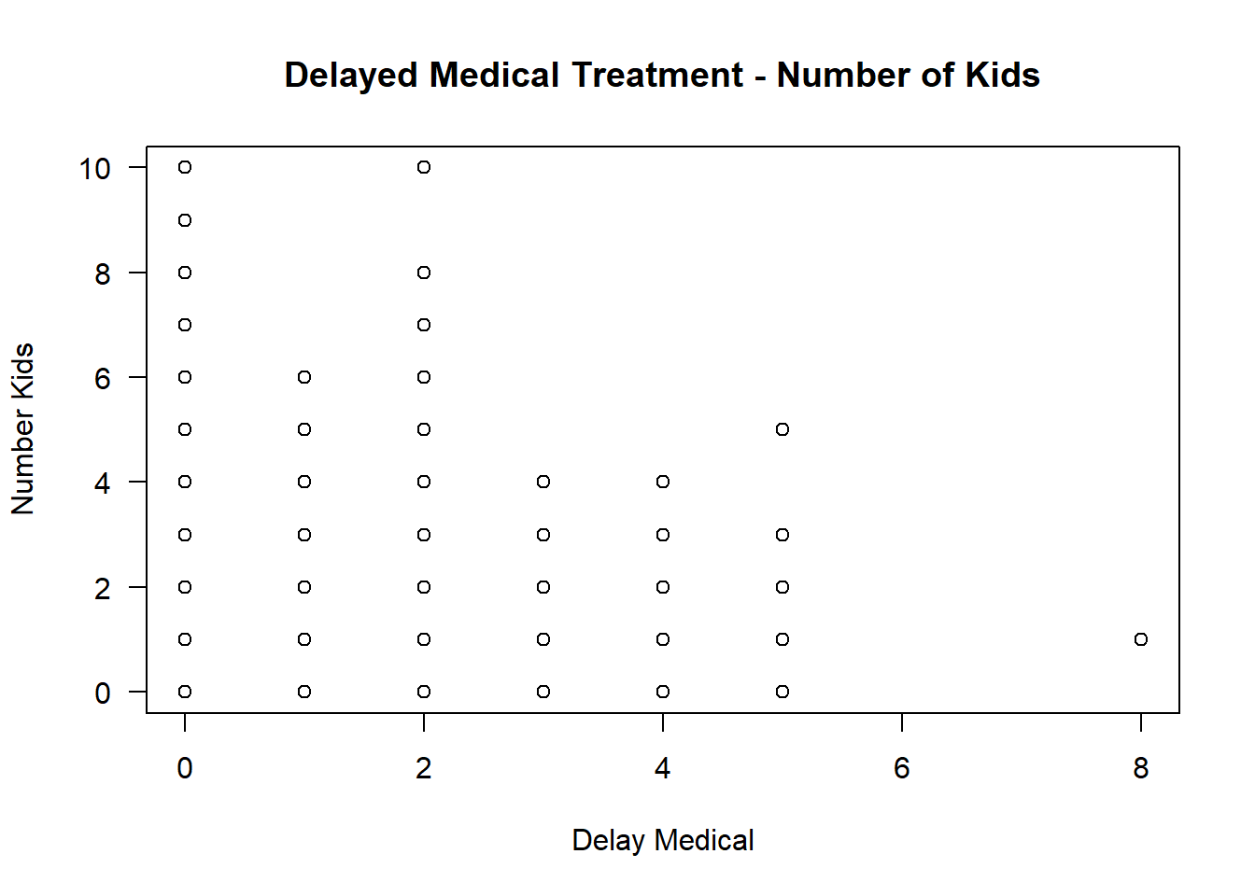
GRAPHS

Slide 6
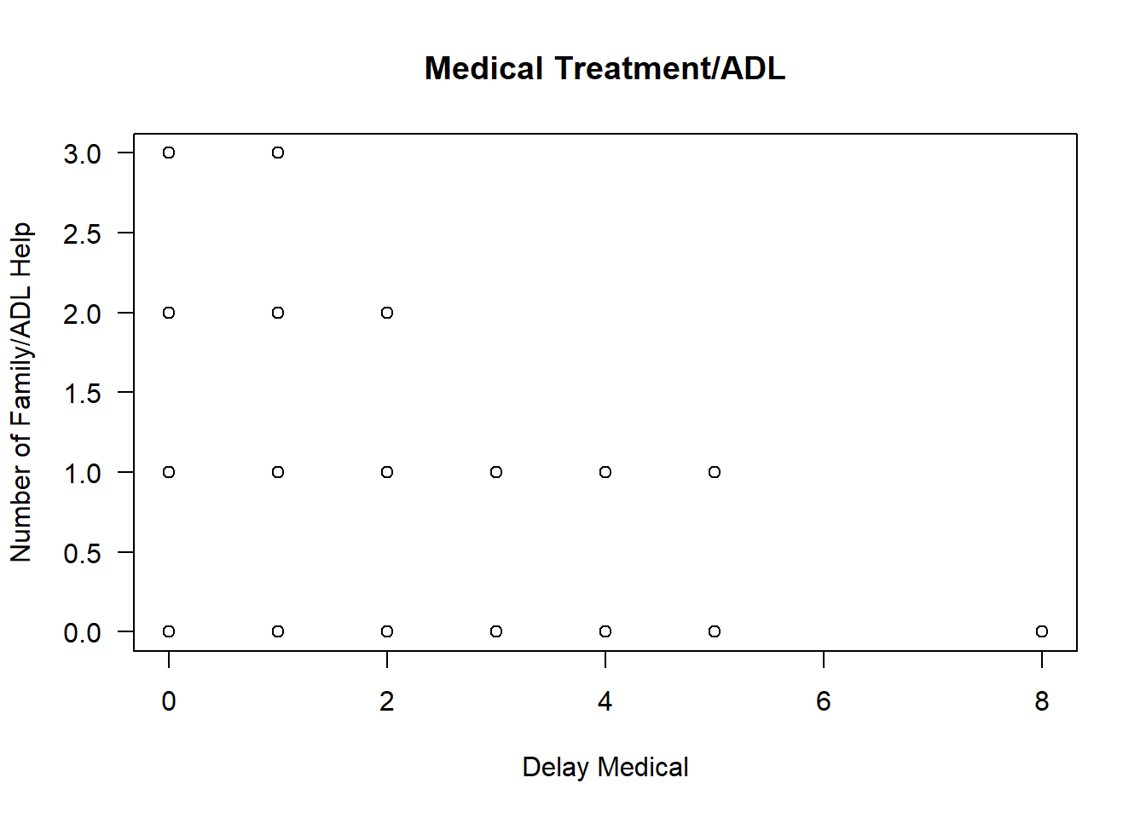
Graphs

Slide 7
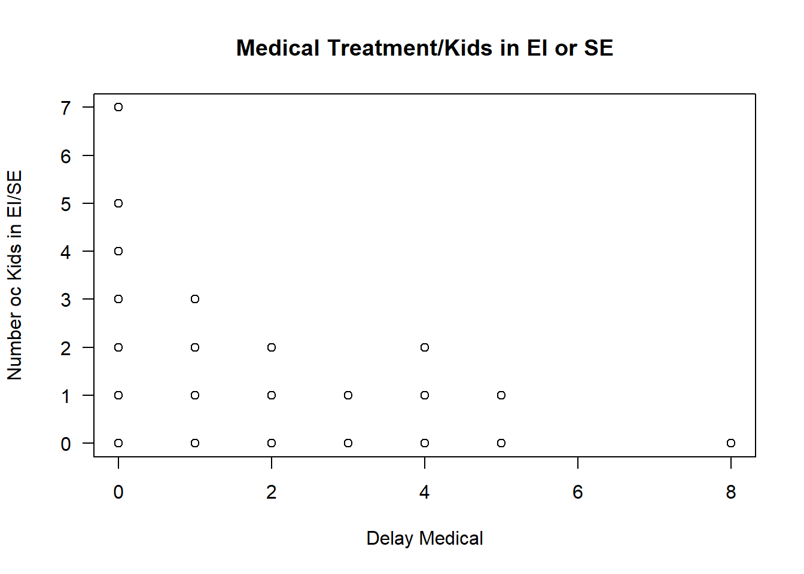
GRAPHS

Slide 8
Pearson Correlation Coefficients
Variables | Number of Times Medical Care was Delayed
Number of Children | .0285
Number of Children in Special Ed. or EI | .0577
Number of Family Members with ADL Help | .0637

Slide 9
FINDINGS
The tables and graphs above show that the correlations between numnomed and the other three variables (numADL, numSEDEI, numkids) are surprisingly very weak.
The strongest correlation is between numNomed and numADL (0.06), followed by numNomed and numSEDEI (0.057). The correlation between numNomed and numKids is the weakest (0.02).
These results suggest that delaying medical care is weakly associated with the number of children in general, but marginally more strongly associated with having children who have special healthcare needs.
One explanation for these weak correlations could be that this sample does not contain enough families with children with special healthcare needs or families with more than one child. Future research is warranted.

